Slide 1
1. Teacher Instructions
Pre-visit: Introduction video and quiz
Length: Approximately 30 minutes
Description: This lesson is aimed at preparing your students for their visit to the WTP..
Overview:
Watch the video that introduces the Circular Cities Digital Challenge and the Teams
Allocate your students into teams to participate in the game
Complete a quiz to find out how much students know
See Introduction lesson: It includes key content and terms to help students participate in the Future Water Story
***See Notes on each slide for more teaching notes and ideas***

Slide 2
Instructions
The following is a suggested sequence of activities and time allocation. You might want to spend more or less time on specific sections depending on your class and their learning requirements. All resources can be edited to suit your teaching needs.
Slide | Description | Time
Section: Preparing for your visit
1.1: Future Water Story | Introducing the challenge and the teams | 10 minutes
1.2: The teams | Allocating your students into groups | 10 minutes
1.3: Quiz | Test your students’ water knowledge with a pre-visit quiz | 10 minutes

Slide 3

The Future Water Story
Pre-visit lesson

Slide 4
Learning outcomes
Know that water is a scarce resource, and it needs to be managed to ensure water security​
Know that the liveability of Melbourne depends on a safe and secure supply of water; as well as treatment of wastewater​
Understand that Melbourne's water security will be impacted by climate change
Notes:
Teaching notes & ideas:
You could add how population growth and climate change will impact water security in Melbourne.
The focus of the Future Water Story is on Melbourne, you could add reference to other cities around the world your class is investigating.

Slide 5
Preparing for your visit
Notes:
Teaching notes & ideas
The next slides are aimed at getting your students ready and excited to participate in the Future Water Story.

Slide 6
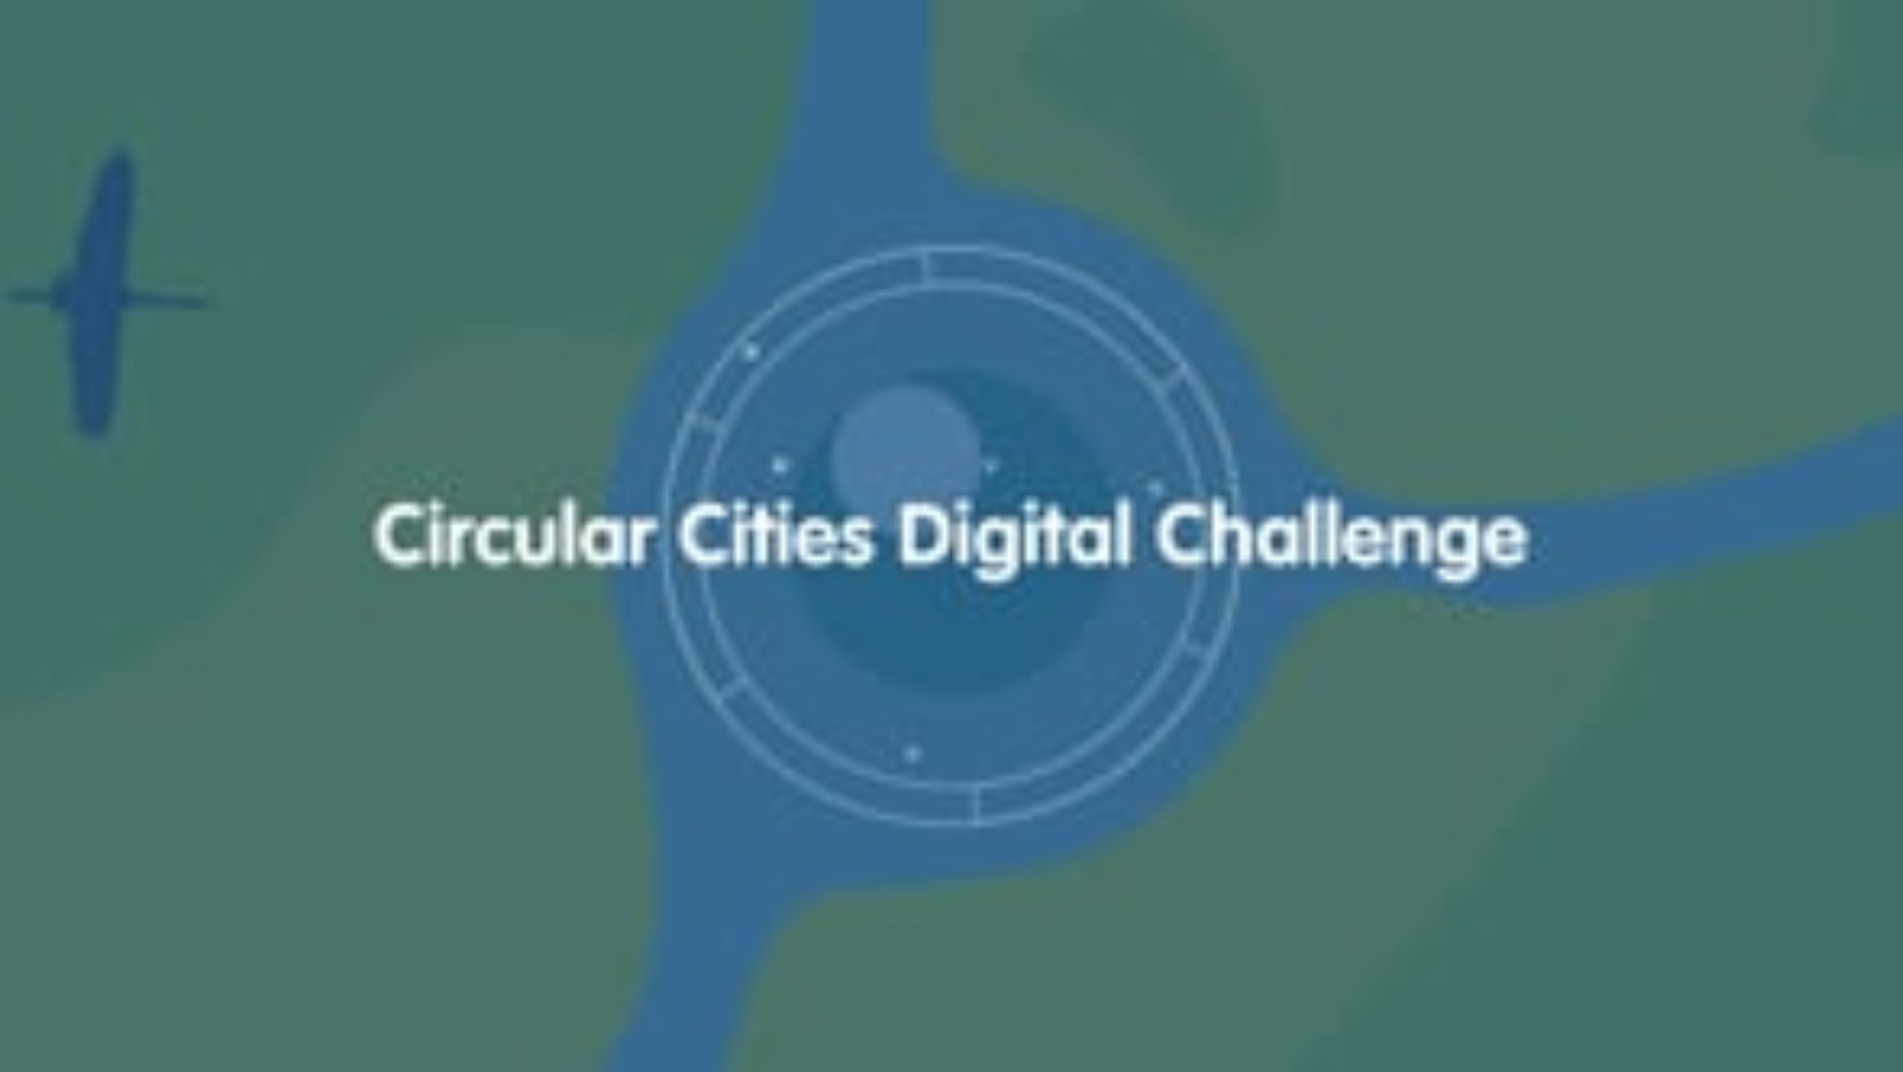
1.1: Future Water Story – introducing the challenge & teams!
Notes:
Teaching notes & ideas
Watch the video
Your students need to be allocated into teams. You may choose to allocate students or get them to nominate the group they would like to be part of. When students are participating in the challenge, they will need to consider the ‘needs’ and ‘requirements’ of their group.
The groups:
Banksia Sports
Culture Ark
Collins Family Farm
Creekside Science
Wattle School Parents & Friends (P&F)
Health & Hue

Slide 7

1.2: Future Water Story – the teams!
Notes:
Teaching notes & ideas
Your students need to be allocated into teams. You may choose to allocate students or get them to nominate the group they would like to be part of. When students are participating in the challenge, they will need to consider the ‘needs’ and ‘requirements’ of their group.
The groups:
Banksia Sports: a new sports club that believes a new space for community activities will become the heart of the city
Culture Ark: a collective of individuals that are working to preserve the town’s heritage
Collins Family Farm: a young farmers believe that healthy land and food security is the foundation of a strong city
Creekside Science: a collective of citizen scientists are passionate about science and using research to drive smart decisions
Wattle School P&F: a parents and friends’ They believe that strong schools make strong communities
Health & Hue: a small fashion start-up with big designer dreams

Slide 8
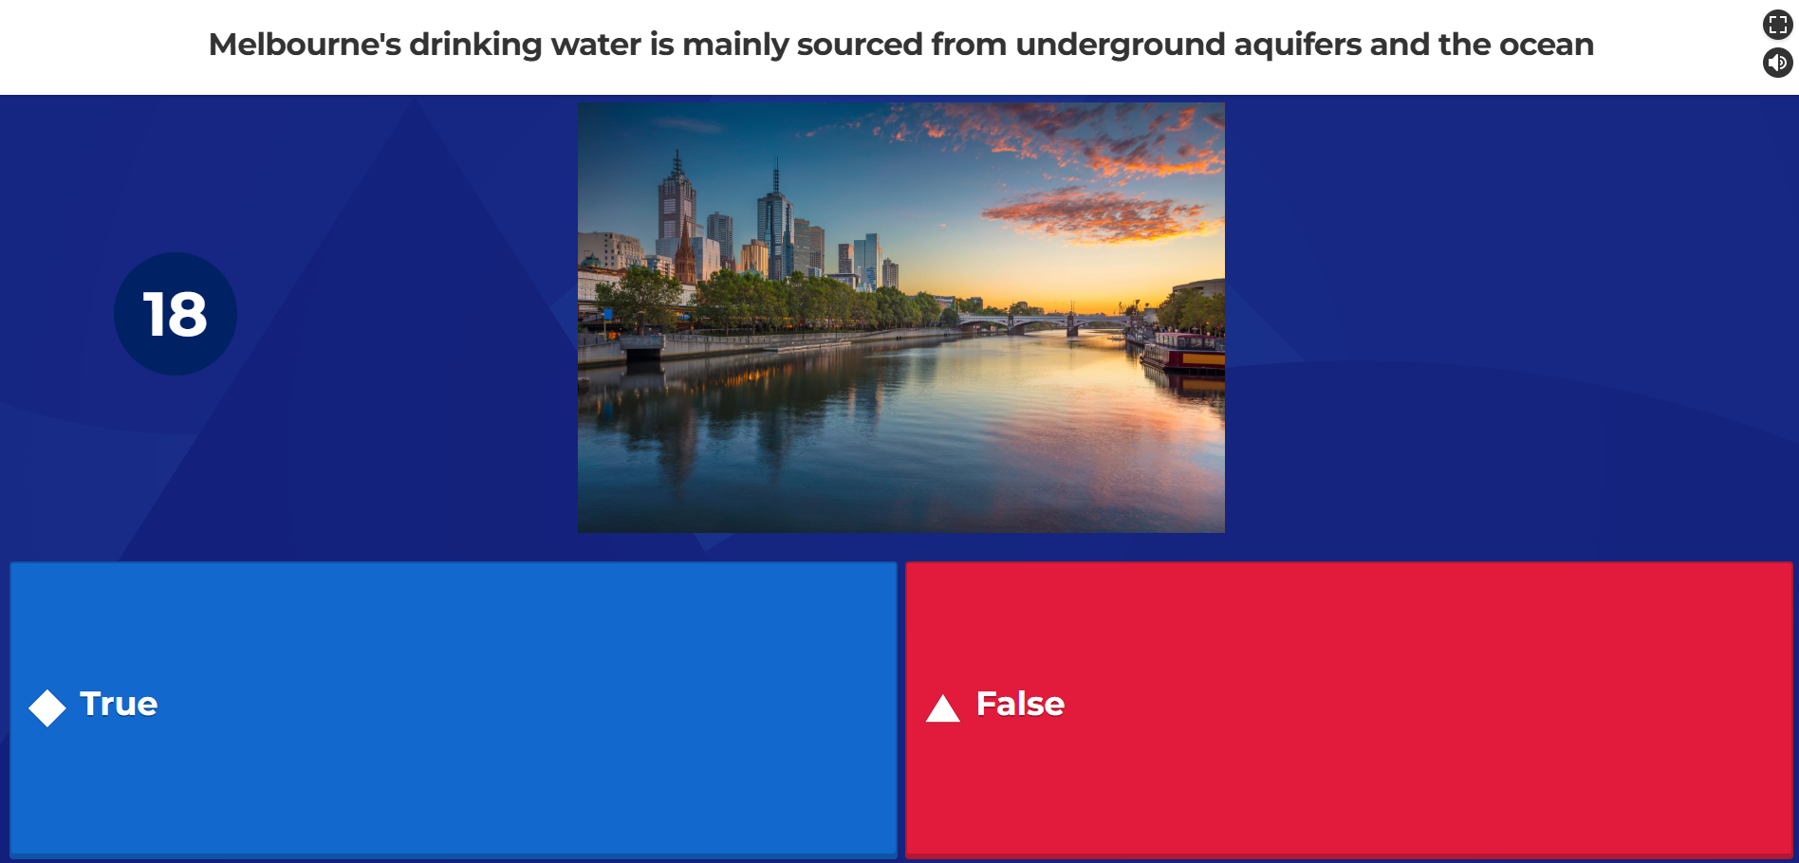
1.3: Quiz
Notes:
Teaching notes & ideas
To help us tailor the upcoming excursion for your students, we’ve put together a short pre-visit Kahoot quiz. This will give us insight into their current knowledge, allowing us to focus on the most relevant topics during the visit.
Step 1: Go to your introduction email
Step 2: Open the link to the Kahoot quiz and share it with your students, there are 7 true of false questions
Step 3: Have students take the quiz in their preset groups and use their team’s name
Each group will require a device to participate in the quiz (laptop, tablet or phone)
The quiz will take around 5-7 minutes to complete
Step 4: Debrief after the students have completed the quiz. You can get the teams to share their results and/or ask them if they were surprised by some of the correct answers

Slide 9
Are you ready for the
Future Water Story?

Slide 10
Curriculum links
Geography: VC2HG8K03, VC2HG8K04, VC2HG8S01, VC2HG8S03, VC2HG8S04
Science: VC2S8H03

